Slide 1
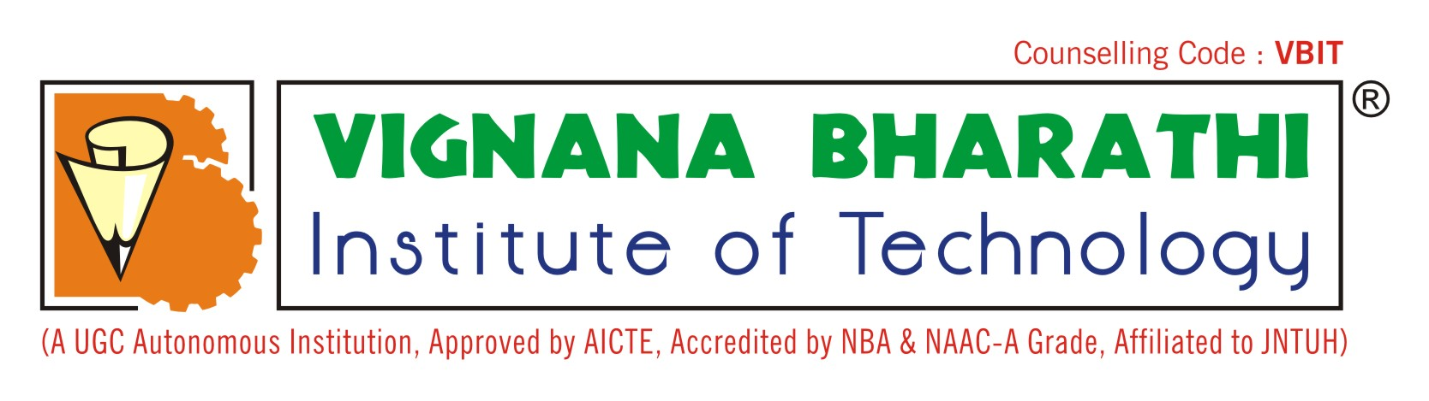
MINOR PROJECT ABSTRACT REVIEW
ON
CENTRALISED DIGITAL PLATFORM FOR COMPREHENSIVE STUDENT ACTIVITY RECORD IN HEIs
TEAM MEMBERS
PROJECT GUIDE : MS.P. SONY
A. RITHVIK | A. REKHA SRI MOUNICA | P. LOHITAKSH
23P61A1202 | 23P61A1206 | 23P61A1260

Slide 2
AGENDA
OBJECTIVE
ABSTRACT
LITERATURE REVIEW
EXISTING SYSTEM
PROPOSED SYSTEM
ARCHITECTURE
SOFTWARE REQUIREMENTS
HARDWARE REQUIREMENTS
CONCLUSION
REFERENCES

Slide 3
OBJECTIVE
To develop a centralized digital platform that securely stores, verifies, and manages all student academic, co-curricular, and extracurricular records in a single system, enabling easy tracking and portfolio generation.
To enhance institutional efficiency and transparency by reducing administrative workload, supporting accreditation and compliance reporting (NAAC/AICTE/NIRF), and improving the overall record management process in higher education institutions.

Slide 4
ABSTRACT
Higher education institutions face challenges in managing student academic and non-academic achievements due to fragmented, department-wise, and non-digital record systems, leading to increased administrative workload and difficulties in accreditation processes such as NAAC, AICTE, and NIRF.
The Smart Student Hub is a centralized web and mobile-based platform that digitally captures, verifies, and manages the complete student journey through a unified dashboard, enabling student portfolio generation, faculty-based verification, automated accreditation reporting, LMS/ERP integration, improved transparency, and efficient digital administration.

Slide 5
Literature Review
1. Web-Based Student Information Systems in HEIs
Author: A. Kumar, S. Singh
Journal: International Journal of Computer Applications, 2019
This study discusses the design of web-based student information systems to manage attendance, marks, and academic profiles. It emphasizes centralized data storage and role-based access for faculty and students.
Limitation: Does not include activity records or accreditation-oriented reporting.

Slide 6
Literature Review
2. Digital Transformation of Academic Record Management
Author: R. Mehta, P. Joshi
Journal: International Journal of Education and Management Engineering, 2020
The paper highlights how digital platforms reduce paperwork and improve transparency in higher education administration.
Limitation: Focuses mainly on administrative data and lacks student-driven dashboards.

Slide 7
Literature Review
3. Role-Based Access Control in Educational Management Systems
Author: N. Sharma, K. Verma
Journal: IJCSIT – International Journal of Computer Science and Information Technologies, 2018
This work explains how RBAC improves security and data integrity in academic systems by restricting access based on roles such as student, faculty, and admin.
Limitation: Does not address record verification workflows or portfolio generation.

Slide 8
Literature Review
4. Online Academic Portfolio Systems for Students
Author: J. Wilson, M. Brown
Journal: International Journal of Emerging Technologies in Learning (iJET), 2021
The paper focuses on digital student portfolios for placements and higher studies, highlighting the importance of verified academic records.
Limitation: Lacks institutional integration and automated reporting features.

Slide 9
Literature Review
5. Automation of Accreditation Data Management in HEIs
Author: S. Rao, V. Reddy
Journal: International Journal of Educational Administration and Policy Studies, 2022
This study discusses challenges faced by institutions during NAAC and AICTE inspections due to manual data collection and fragmented systems.
Limitation: Proposes automation conceptually but does not present a full student-centered platform.

Slide 10
Existing System
In the existing system, student academic records, certifications, internships, and extracurricular activities are maintained separately by different departments, physical files, and multiple digital platforms such as E-CAP, making it difficult to access and manage all information at a single time.
Due to the absence of a unified system, students are unable to present a complete and verified profile of their academic and non-academic achievements, especially for placements, higher education, and scholarship applications.
Faculty and administrators spend significant time on manual verification, record tracking, and report preparation, while institutions face difficulties during accreditation processes like NAAC, AICTE, and NIRF because of fragmented and inefficient record management.

Slide 11
Proposed System
The Smart Student Hub is a centralized web and mobile-based platform that stores all student academic and activity-related records in a single digital system, allowing students to upload achievements, track progress through a unified dashboard, and generate verified digital portfolios.
The system includes a faculty-based approval mechanism to verify student records and ensure data authenticity, with real-time status updates visible to students for each submitted record.
Smart Student Hub supports automated accreditation report generation, integrates with existing ERP and LMS platforms, reduces paperwork, and improves transparency, efficiency, and overall student record management in higher education institutions.

Slide 12
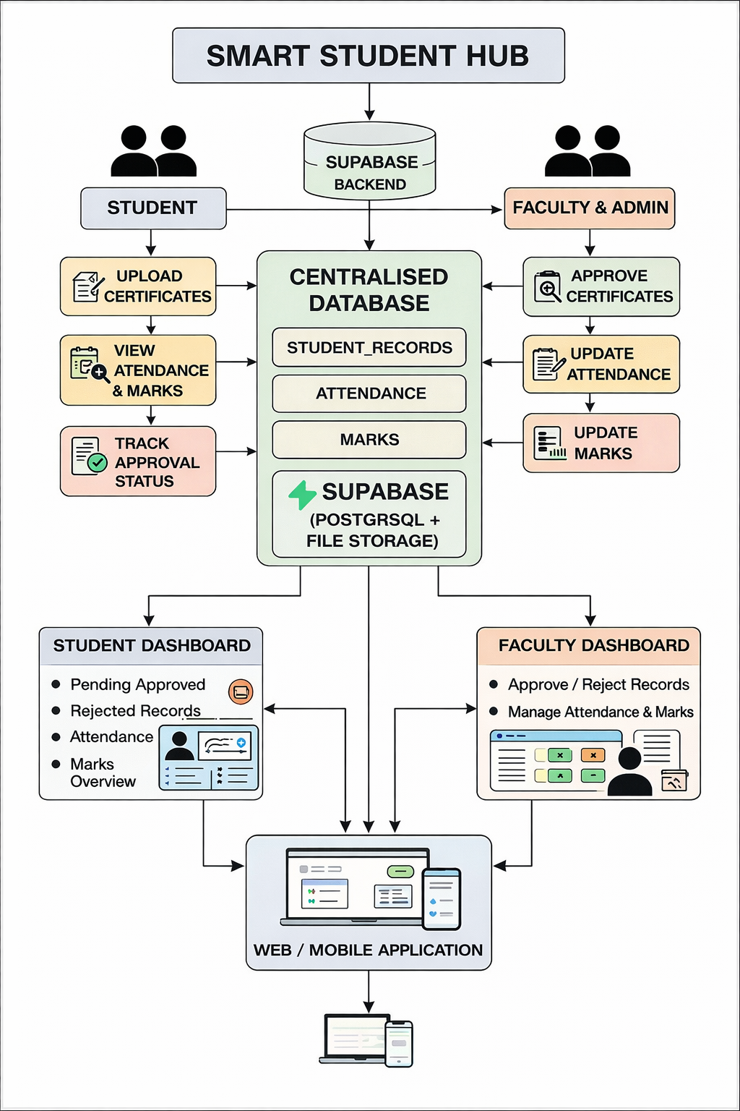
Architecture Diagram

Slide 13
Technologies Used
Software Requirements
Hardware Requirements
React js
Tailwind Css
Type script
Supabase(Database and Backend)
Generative AI Tools(For AI Integrations)
Operating System: Windows / Linux / macOS
RAM: Minimum 4 GB
Internet

Slide 14
Conclusion
The Smart Student Hub provides a centralized and digital solution for managing complete student academic and activity records, eliminating fragmented data storage and improving accessibility for students, faculty, and administrators.
By incorporating role-based dashboards and faculty verification mechanisms, the system ensures data authenticity, transparency, and efficient record management while reducing manual workload and paperwork.
The platform supports institutional requirements such as accreditation reporting and digital portfolios, and serves as a scalable foundation for future integration with ERP, LMS, and AI-driven analytics in higher education institutions.

Slide 15
References
1. Web-Based Student Record Management
O. O. Ajayi, A. A. Ajayi,
“Web-Based Students’ Record Management System for Tertiary Institutions,”
International Journal of Advanced Research in Computer Science and Software Engineering, 2014.
🔗 https://www.ijarcsse.com/docs/papers/Volume_4/2_February2014/V4I2-0274.pdf
2. Student Information Management System
S. R. Bharamagoudar, R. B. Geeta, S. G. Totad,
“Web Based Student Information Management System,”
International Journal of Advanced Research in Computer and Communication Engineering (IJARCCE), 2013.
🔗 https://ijarcce.com/wp-content/uploads/2013/01/IJARCCE6A-s-s.pdf
3. Academic Record Management System
A. A. Adekunle, O. O. Aderibigbe,
“Design and Implementation of Academic Record Management System,”
International Journal of Computer Applications, 2014.
🔗 https://www.ijcaonline.org/archives/volume100/number12/17545-8014

Slide 16
4. Role-Based Access Control in Educational Systems
R. S. Sandhu et al.,
“Role-Based Access Control Models,”
IEEE Computer, vol. 29, no. 2, pp. 38–47, 1996.
🔗 https://ieeexplore.ieee.org/document/485845
(Used widely to justify student/faculty/admin roles)
5. Digital Student Portfolio Systems
Helen C. Barrett,
“Electronic Portfolios: A Chapter in Educational Technology,”
Educational Technology, 2007.
🔗 https://electronicportfolios.org/portfolios/LEAJournal.pdf
6. Automation in Higher Education Administration
A. Al-Azawei, F. Serenelli, K. Lundqvist,
“Universal Design for Learning (UDL): A Content Analysis,”
Journal of the Scholarship of Teaching and Learning, 2016.
🔗 https://scholarworks.iu.edu/journals/index.php/josotl/article/view/17369
7. Accreditation & Academic Data Challenges
NAAC,
Manual for Self-Study Report (SSR) – Higher Education Institutions,
National Assessment and Accreditation Council, India.
🔗 https://naac.gov.in/index.php/en/assessment-accreditation

Slide 17


